Slide 1
Introduction to Web Development: HTML

Slide 2

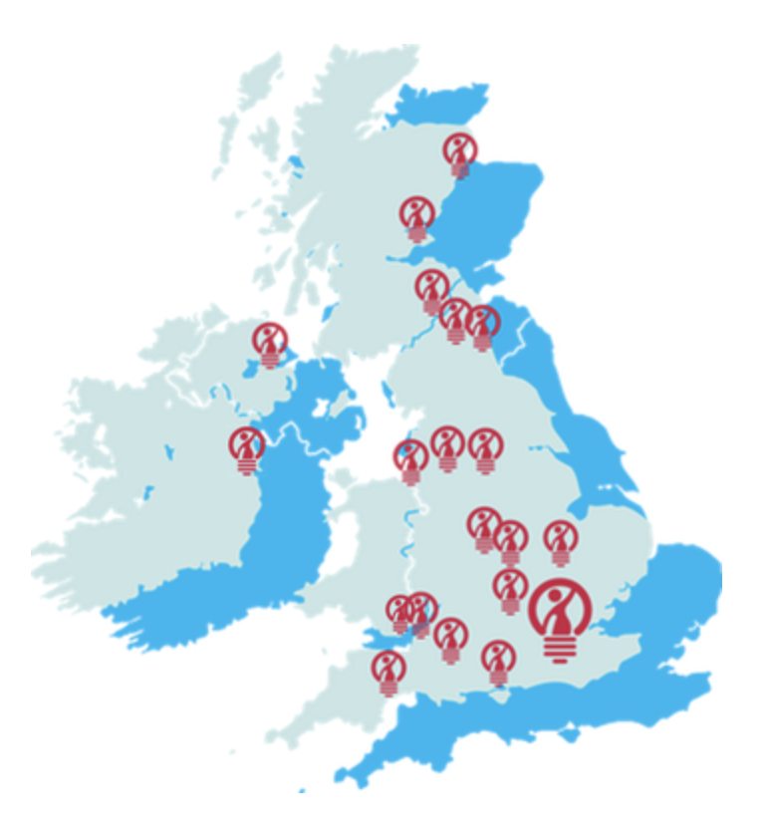

Welcome!
You’re joining a community of female coders all over the UK!

Slide 3



Who are we?
Lisa
Clare
Penny

Slide 4
Ice Breaker
Sit on tables in groups of at least 4
Using the paper in front of you, write a little ‘About Me’ section for each member of the group, including:
Name
Hobbies
What coding experience you have
What made you want to make websites

Slide 5
What we will be learning…
Week 1 – Setup, welcome session, Intro to HTML
Week 2 – CSS and Github
Week 3 –Recap and UX (User Experience), course competition intro
Week 4 – Bootstrap and advanced styling
Week 5 - JavaScript and JQuery
Week 6 – Plugins, website metrics, hosting,
Week 7 – Course competition presentations and wrap up

Slide 6
Course Social and Competition

Slide 7
Let’s Get Social
Potential date: Friday 9th February
Potential activity:
Bowling
Casual pub social
Pizza making
Go for a meal
Watch a movie
Other suggestions?

Slide 8
#leedscodefirst

Slide 9
Web Development Time!

Slide 10
HTML, CSS and JavaScript
Demonstration CLICKY!!
HTML HyperText Markup Language | CSS Cascading Style Sheets | JavaScript
A mark up language Describes the structure of web pages HTML documents are described by HTML tags, and each tag describes different elements. | A stylesheet language Describes the presentation of web pages including colors, layouts and fonts It enables responsive design; for one to adapt the presentation to different types of devices | A programming language Allows user interactivity, and enables web pages to be dynamic (usually without needing to reload the page) *it is a type of programming language, scripting
Helpful analogy: HTML is for saying “there’s a box on the page”, CSS says “that box is pink” and JavaScript is for saying “when you click on that box, an alert will pop up!”

Slide 11
Introduction to HTML

Slide 12
What is a website, what is a webpage?
1. Lets look at some website source code
CLICKY
2. Let’s look at a code editor:

Slide 13
What is HTML?

Slide 14
Downloads!
Text Editing programme Atom – https://atom.io
Google Chrome https://www.google.com/chrome/browser/desktop/index.html

Slide 15
Task 1 - Looking at Page Sources of Websites

Slide 16
Text Editors

Slide 17
Task 2 – Create a HTML Page
1. Create a new folder on your computer, call it CFG_projects or something similar
2. In the folder create a file using a text editor (eg. Textedit on Mac). Save it as index.html
3. Write the word ‘hello’ in the file, save and open in web browser
4. You just made a web page!
5. Now change the text to <h1>hello</h1>
When you open it in the browser, what do you see?

Slide 18
Basic HTML Page Layout
Underneath every pretty web page, there is HTML at work, creating the layout of the page. It essentially splits the sections of the page into boxes, which you then fill with other things, like text and images.
Each box on the page is created using opening and closing triangle brackets. You specify what part of the page it is by writing an element name in the brackets.
Eg. The header would be written:
<header>
Some text here. Maybe a logo image too.
</header>
<header>
<nav>
<section>
<aside>
<article>
<footer>

Slide 19
Basic HTML Page Layout
The version of HTML you are using
<!DOCTYPE html>
<html>
<head>
<title>Page title</title> …
</head>
<body>
…
</body>
</html>
The beginning of the HTML document
The brains of the website
(info about the website/metadata)
The visible part of the website in the browser
The end of the HTML document

Slide 20
What are elements?
<h1>Hello World</h1>
<img src=“smileyface.jpg” alt=“A smiley face” />
List of HTML elements at W3Schools CLICKY

Slide 21
What are tags?
<tag attribute=“value”>
The tag opens here
The content of the element is contained in an attribute
The tag closes here

Slide 22
What are attributes?
List of main HTML attributes at W3Schools CLICKY
<tag attribute=“value”>
Quote marks surrounding the value of the attribute
No spaces on either side of the = sign
<div class=“info-section”>
<img src=“smileyface.jpg” alt=“A smiley face” />
<a href=http://google.com >

Slide 23
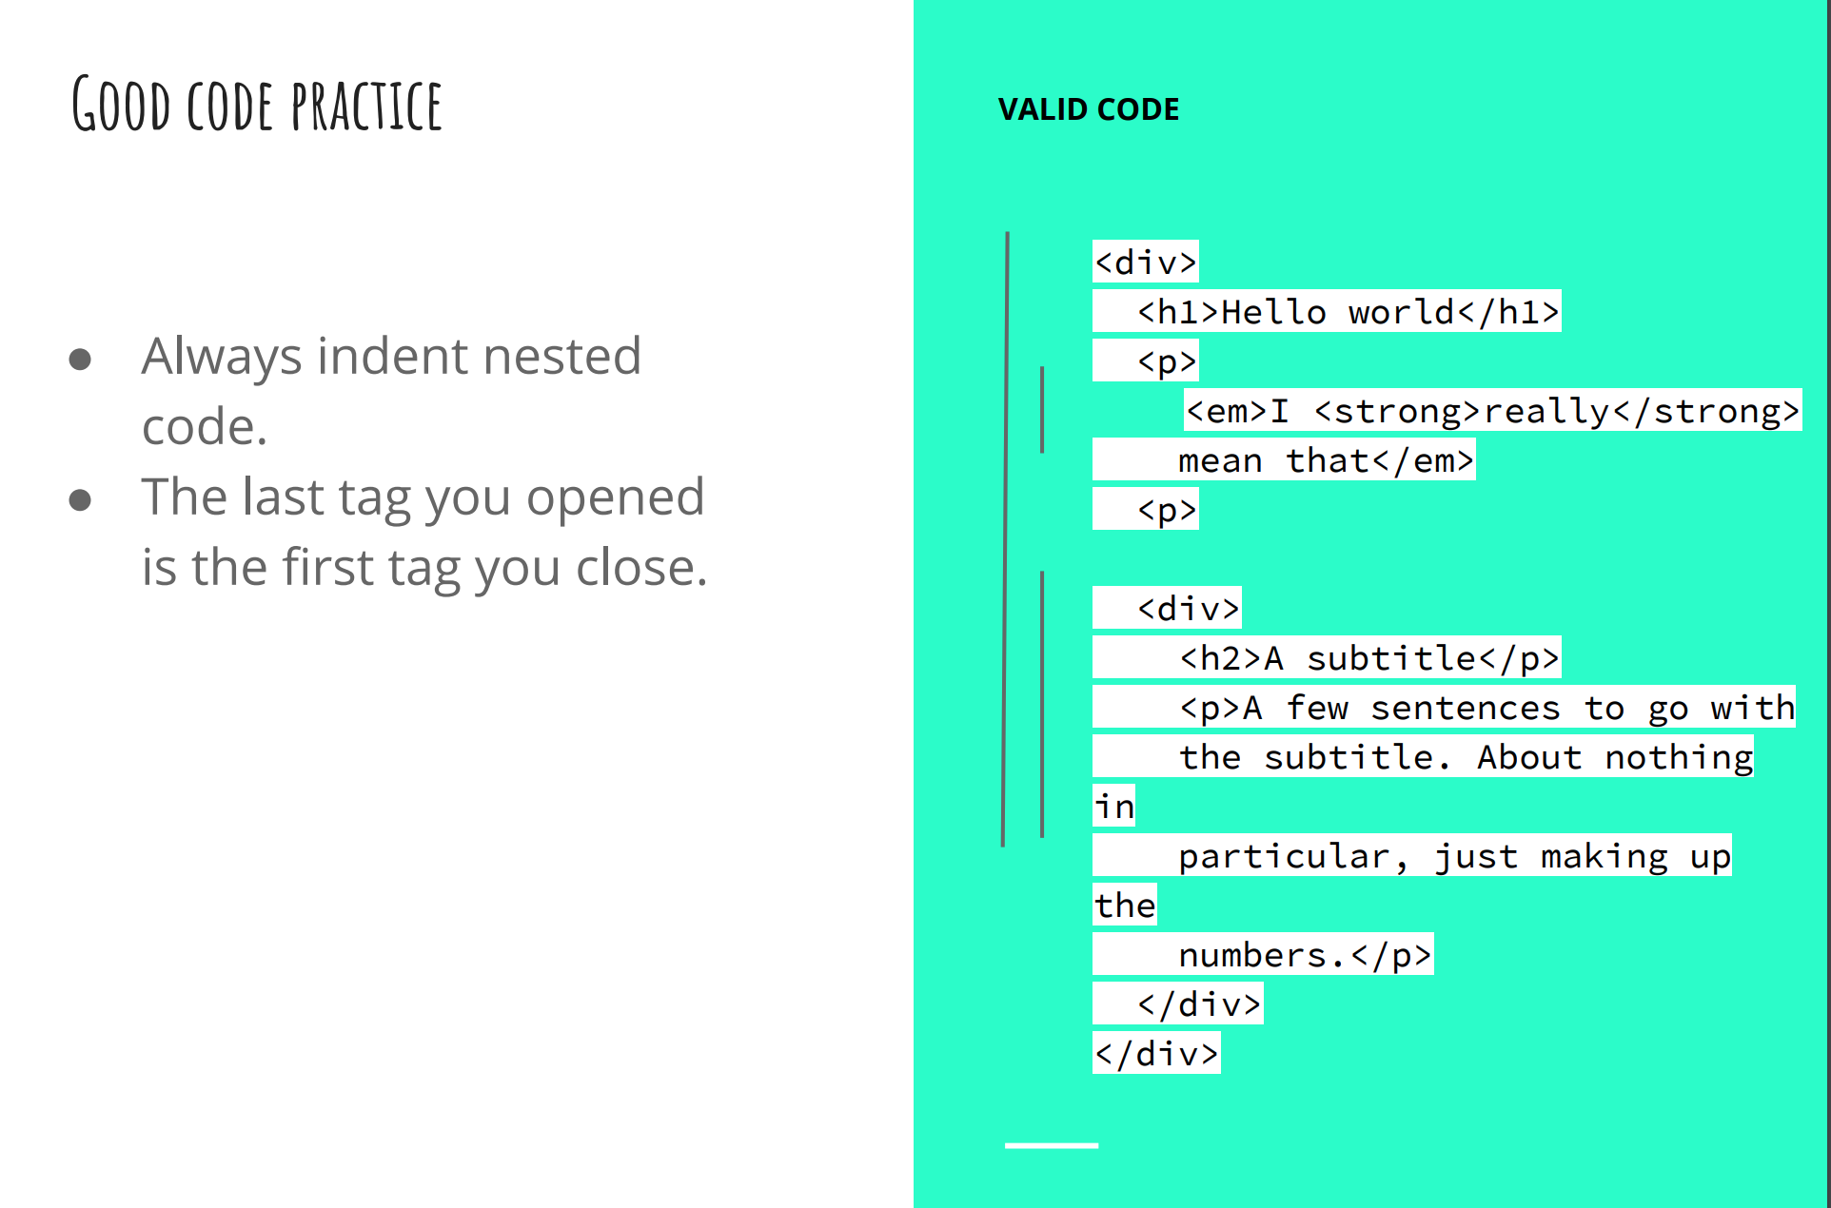
Nesting

Slide 24
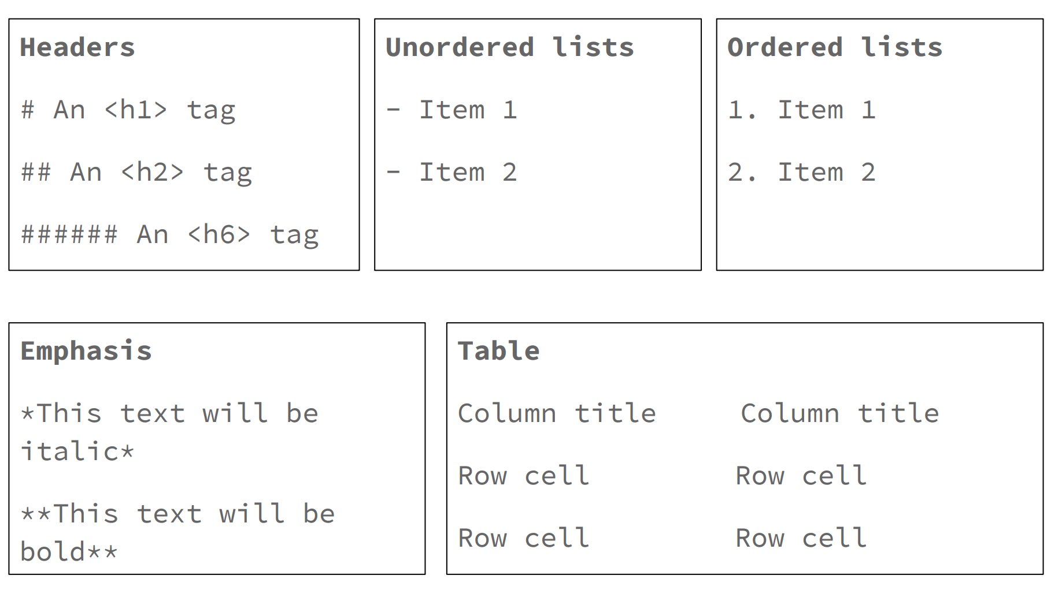
HTML Syntax Demo
Click here to show live demo of HTML syntax

Slide 25
Task 3 – About Me Page
1. Open this code demo:
https://codepen.io/dianaklee/pen/rOMzNj?editors=100
2. Using it as a guide, create an About Me page in the ‘index.html’ file you created before. To see how it looks, double click the file to open it in your web browser.
Ask if you have any questions!

Slide 26
Homework!
1. Register on:
https://dash.generalassemb.ly
2. Complete project 1 and 2 of the HTML tutorial
3. Finish your About Me page to show in next class
See you next week!

